Slide 1

Hunter x Hunter or Made in Abyss?
A User-Empowered Anime Recommender System
Binh Hoang

Slide 2





Anime Streaming War
Global anime market valued at $20 bn in 2018 and growing

Slide 3
Recommender Systems as Competitive Edge
Crunchyroll’s first recommender system (2020)

Slide 4



Data
ANIME RATINGS
FROM 120,000 USERS
1,000
TOP ANIME

Slide 5
Methodology
Web Scraping
Data Storage
Recommender
Visualizations
BeautifulSoup
Selenium
Docker
Google Cloud Platform
MongoDB
Scikit-learn
Pandas
Numpy
Seaborn
Flask (HTML/CSS)

Slide 6
Hybrid Recommender System
 | Content-based Filtering | Collaborative Filtering
Method | User embedding is average of anime features for anime user has watched | NMF (non-negative matrix factorization) to learn latent features for user/anime embeddings
Features | Genre Media type (e.g. TV, movie, ONA) Content-rating (e.g. PG, PG-13, R) Number of episodes Average user score Number of members (aka followers) Age (i.e. years since premiere) | Animation quality Popularity Supernatural/fantasy Shounen Slice-of-life Action-packed classic
Distance Metric | Cosine similarity | Cosine similarity

Slide 7




Recommender System Pipeline
Anime A: 10 points
Anime B: 6 points
Anime C: 12 points
.
.
.
Anime T: 8 points
Anime C: 12 points
Anime A: 10 points
Anime T: 8 points
.
.
.
Anime B: 6 points
Content-based Filtering
10 anime
20 anime
10 anime
10 anime
Collaborative
Filtering
1,000
TOP ANIME
CANDIDATE GENERATION
SCORING
RE-RANKING
RECOMMENDATION

Slide 8





User alesyasabri1 Anime Profile
alesyasabri1
Watches a lot of shounen anime (66%)

Slide 9

Content-based Filtering
Kuroko No Basuke
(another shounen anime)

Slide 10

Collaborative Filtering
Mo Dao Zu Shi
(visually stunning mature action anime)

Slide 11
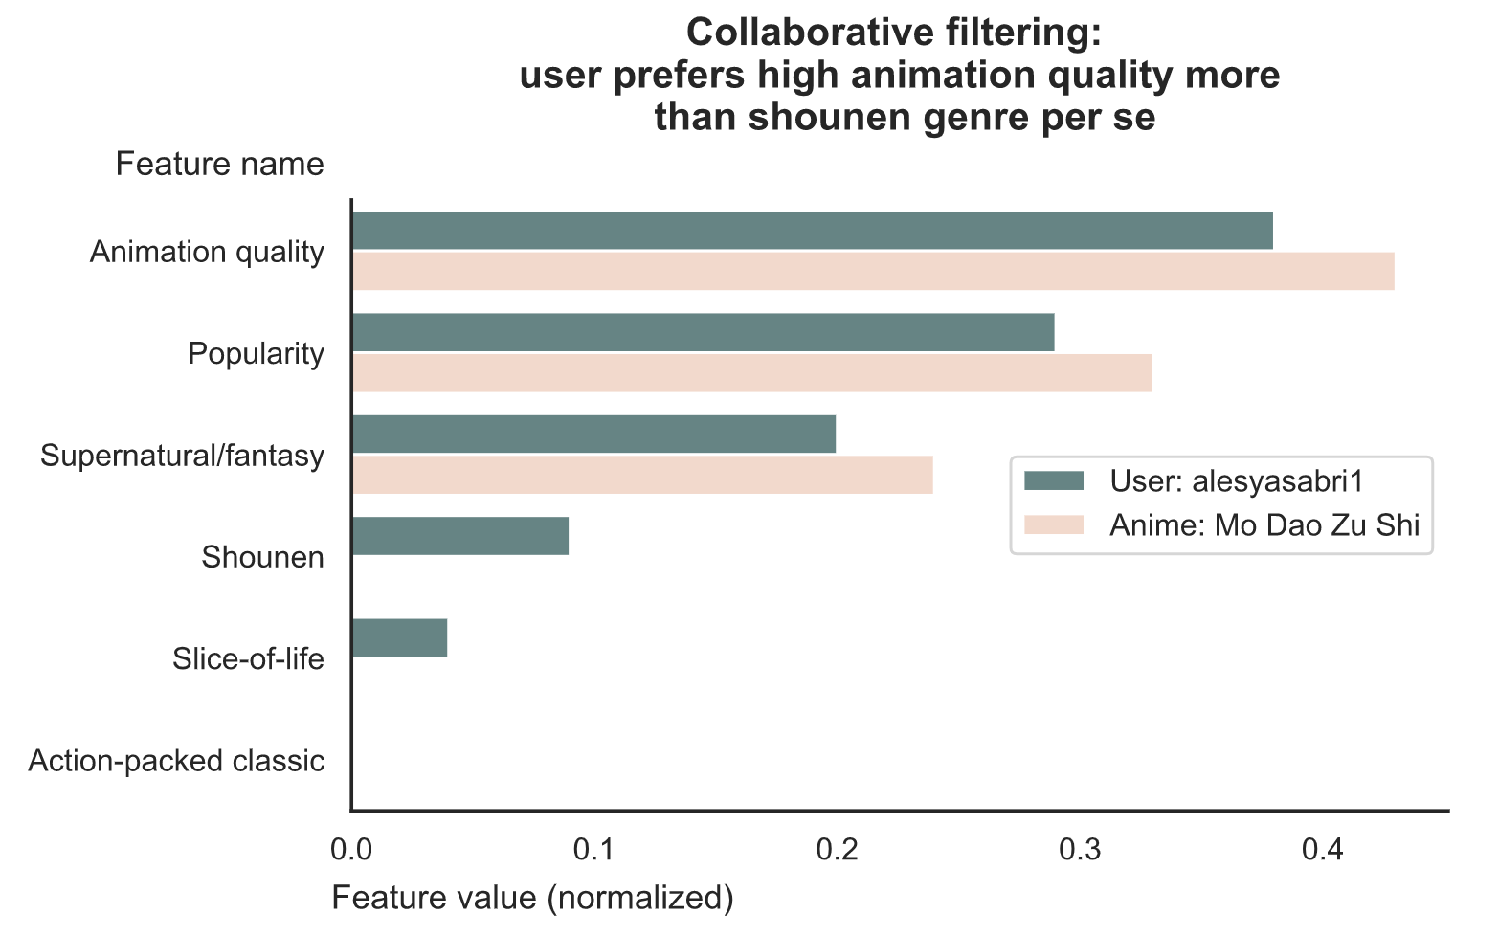
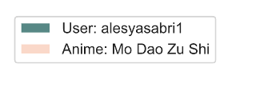

Slide 12



Empower Users
Flask App
Less Adventurous
(content-based filtering)
Balanced
(mix of both)
More Adventurous
(collaborative filtering)

Slide 13

Thank you
Binh Hoang
LinkedIn: binh748
GitHub: binh748
Images/data were sourced from the internet for educational purposes

Slide 14
Future Work
Collate anime seasons/movies of a single anime into one listing so not recommending the same anime repeatedly (explain what I mean with an example)

